Slide 1
Fundamental of Automation with TCoE
By Tran Le Trung – Jan 2016

Slide 2
Objective
Introduction on Automation
Test Automation: Common Approach
Understand ROI
Automation with TS TCoE
TS Automation Test Tools

Slide 3
Table of Content
Introduction on Test Automation
Test Automation
ROI
Automation Test Tools
Sample projects

Slide 4
Introduction on Test Automation – Business Need
Faster: Time to market
Development
Testing
Deployment
Better: Quality
Features
Performance
Usability
Cheaper: Competitive Innovation
Elaboration
Implementation
Delivery

Slide 5
Introduction on Test Automation - Challenges
Communication
Validation
Training
Completion
Any from yours?

Slide 6
Introduction on Test Automation- What it is?
The use of special software (not the ones being tested) to control the execution of tests and the comparison of actual outcomes with predicted outcomes.
Automate some repetitive but necessary tasks in a formalized testing process already in place, or add additional testing that would be difficult to perform manually.
Is critical for continuous delivery and continuous testing.

Slide 7
Introduction on Test Automation- Key Requirements
A strategy, a vision and a plan
An architecture and integration
Early lifecycle centric
Roles based and associated training
Aligned and integrated with processes
System under tested focused
With business oriented measures and reporting

Slide 8
Test Automation – Common Approach
Plan/Strategy
Develop Architecture
Pilot & Implement
Measure & Report
Assess

Slide 9
Test Automation - Assess
Build a list of question
To answer why we are automating
To figure out what current status we have
Current test tools
Current processes
To determine what the requirements are
To figure out what the technology trend is
To provide gaps analysis for
Current status
Technology
To come up a list of suggestions
Notes:
What is to be tested?
What levels and types of testing are to be
automated?
What existing test tools do we have?
What processes must interact with the tools?
What other tools must the test tools integrate with?
What are the information (data) needs (input/output)?
What environments are required?
What metrics/reports are required?
---
◦ Test Tool Category
◦ Test Tool Purpose (single function/multi-function)
◦ Test Tool Value ◦ At what lifecycle stage does the test tool apply ◦ What process(es) does the test tool support?
◦ Existing Linkage to other test tools (or team tools)
◦ Test Tool License and Maintenance expenses ◦ How many users (departments, BU’s, teams) ◦ Current Test Tool issues/deficiencies
◦ What Platforms are Supported?
◦ Others?

Slide 10
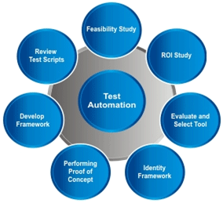
Test Automation – Plan/Strategy
Understand Business Requirement
Identify Automation Areas ( automation testing scope)
Develop Automation Strategy and Detailed Plan
Seek Management Approval and Baseline Scope
Design Framework
Notes:
Tips for Automation Strategy
Evaluate
Proof of concept based on software under tested
Choose tools that are suitable to business requirements and internal technical expertise
2. Plan
Establish goals and objectives; budget
Be ready to have quality metrics to validate the ROI (return of investment)
3. Design
Keep in mind that usability
Choose an architecture that reduces maintenance and extensible
4. Implement
Practice Object Oriented design principles of reusability and modularity
Establish source code control and code review process
5. Test and Maintain
Unit test your code
Constantly re-evaluate reason of maintenance and improve architecture to minimize maintenance.
Evaluate defect rate with root cause analysis

Slide 11
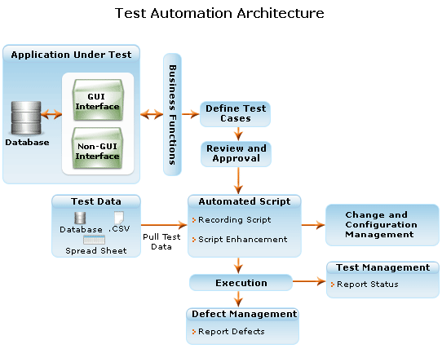
Test Automation – Develop Architecture
Notes:
This is a sample for test automation architecture

Slide 12






Test Automation – Pilot and Implement
Tool requirements specification
Market analysis
Demonstrate tools
Evaluate/pilot a select set of tools
Review of tools
Tool selection/purchase
Notes:
Should draw a flow here

Slide 13
Test Automation – Measure and Report
Measure in technical terms
Comprehensiveness of Functionality
Number of issues in or with the tools
Satisfaction/response time with Tool Support
Ease of use
Ease of Integration
Measure in Business terms
Expansion/scaling
Effectiveness
Pre-release bugs
Post-release bugs
Requirement coverage
Efficiency
QA and Test staff to developer ratio
Time for regression test runs (days)

Slide 14
Test Automation – Measure and Report
Business Results
QA & Test Total Cycle Times (days)
Cost per test cycle
Post release defect containment

Slide 15
Test Automation - ROI
ROI: Return On Investment
ROI = Benefit/Investment = (Gain-Costs)/Investment
Factors
Test automation tool cost
Percentage of test cases that can be considered for automation
Time required for building reusable components, automation frameworks
Cost per test automation resource
Test environment cost
….
For what?
Have the right things been automated?
Has it been built correctly?
When have balance point?

Slide 16
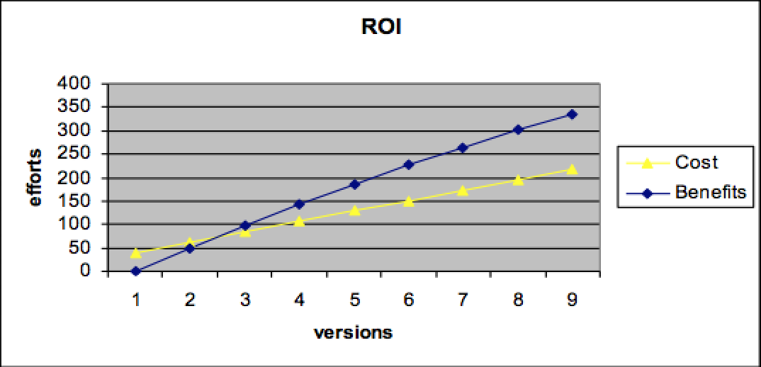
Test Automation – ROI – Sample chart

Slide 17
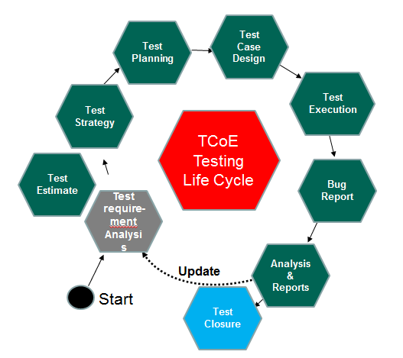
Test Automation with TS TCoE Framework
Test Process
Configuration
Management
Test
Organization
Release
Management
Test
Data
Change
Management
Test
Environment
Test environment
Management
Support Process
Support Tools, Environment
Test
Tools
Software
Development
Lifecycle
Test Metrics
KPIs
Review
Process
Traceability
matrix
Test estimate
document
Test strategy
document
Test plan
document
Analysis
reports
Test case
document
Test
Scripts
Bug
reports
Test summary
reports
Test Artifacts

Slide 18
Test Automation with TS TCoE
What we can do with TS TCoE?
Framework Reference: https://gcsjira.cybersoft-vn.com/wiki/display/TS/3.+GCS+TCoE+Framework+Initiatives+Program
Knowledge Base, Best Practice
Test processes
Tools
Case study
Lesson learn

Slide 19
Test Automation – Tools – Sample comparison
Criteria | QTP | Selenium | Watir | GEB
License | Yes | Open-source | Open-source | Open-source
Scripting Language | VB script | Java, C#, Python, Ruby, PHP, Perl, Javascript | Ruby | Groovy
Object recognition | Object Spy | Selenium IDE, FireBug, FirePath | OpenTwebst (web recorder) | GEB IDE
Script executing speed | High | Low | Low | Low
Framework | Built-in support keyword, data driven or hybrid | Junit, Nunit, Rspec, TestNG | Ruby supported frameworks Rspec, Cucumber, Test:Unit | Grails, Gradle, Maven
Notes:
https://watir.com/
http://www.gebish.org/

Slide 20
Test Automation – Tools
Criteria | QTP | Selenium | Watir | GEB
Continuous Integration | By Jenkins | By Jenkins | By Ruby scripts | Grails, Gradle plug-in
Non browser-based app support | Yes | No | No | No
OS support | Windows | Windows, MAC OSX, Linux depend on web-driver | Windows, Linux, MAC OSX | Windows, Linux
Browser support | IE, FireFox, Chrome | Firefox, IE, Chrome, Opera, Safari | FireFox, IE, Chrome, Opera, Safari | Firefox, IE, Chrome, Opera, Safari
Device Support | iOS, Android, Blackberry, Windows Phone | iOS, Android | iOS, Android | iOS

Slide 21
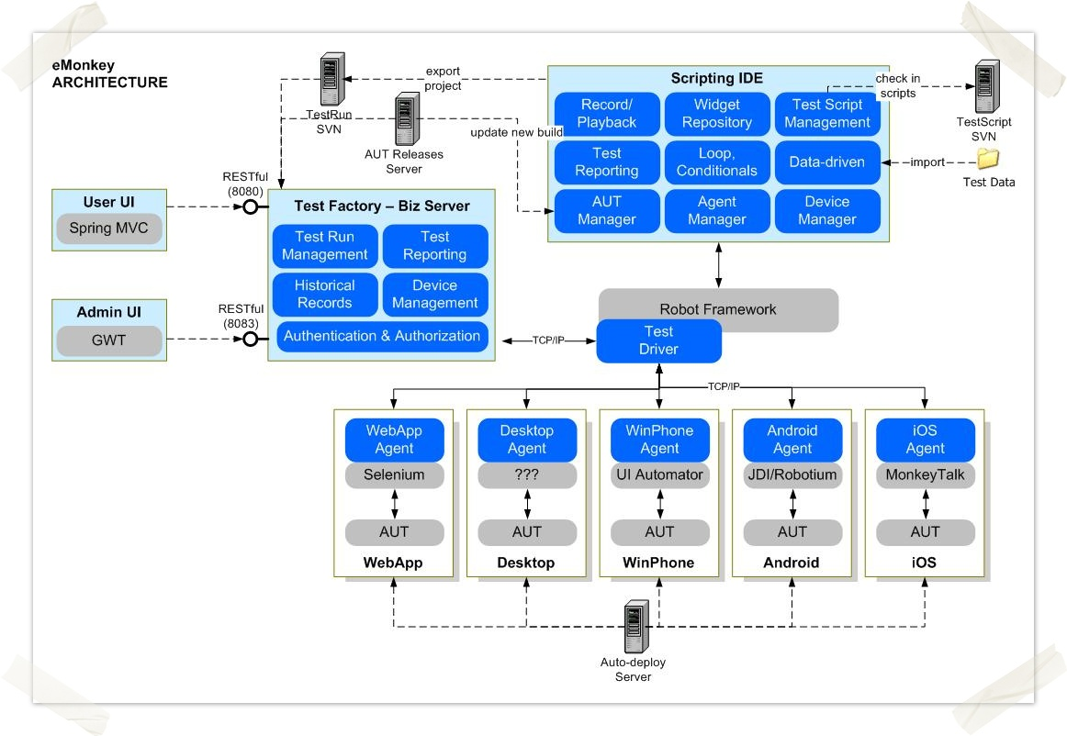
Test Automation – eMonkey
https://gcsjira.cybersoft-vn.com/wiki/pages/viewpage.action?title=EMON+-+GCS+eMonkey+Automated+Testing+Tool&spaceKey=TS

Slide 22
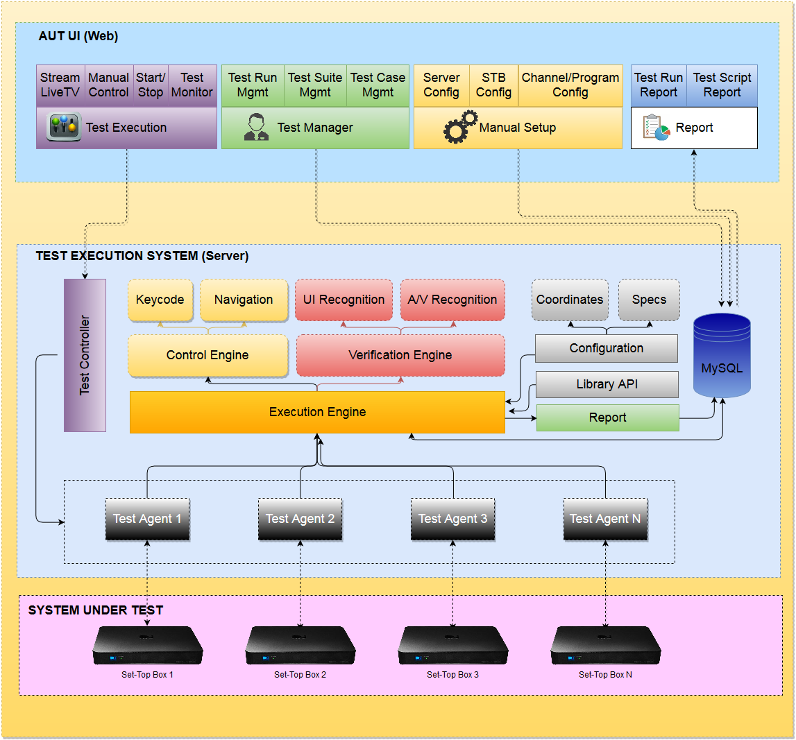
Test Automation – Automation for TV Entertainment

Slide 23


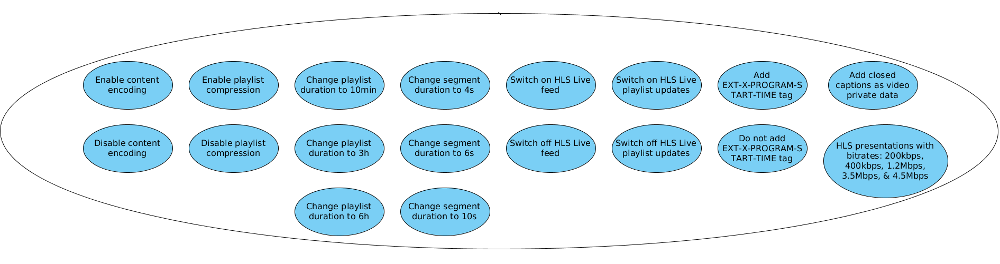
Test Automation: Webkit HLS Test
FUNCTIONAL BLOCK DIAGRAM
Server
WKAT Server
Local HLS Feed Server
TestReport
Local Media
Source
TestApp
(html page, refer js)
file m3u8 playlist 1
(playlist duration 10mins)
file m3u8 playlist 3
(live feed off playlist)
Data
Database
file m3u8 playlist 2
(segment duration 4s)
files m3u8 playlist a,b,c..
(playlists for different bitrates
200kbps, 1.2Mbps,…)
6
4
2
STB
files m3u8 playlist n
(for different stream parameters)
TestApp
Webkit Engine
(HLS APIs)
5
Call js
7
Internet
Live Media
Stream
chiclet:
1
TestApp options (refer to slide: DTV HLS live stream – use case)
Legend:
3
Tester
: We will implement
: http/https protocol
Notes:
Action Flow:
* Pre-condition: Configure one chiclet on STB to point to WKAT Server by https protocol
1) Tester select WKAT chiclet on STB to start download TestApp page (html file) from WKAT Server to STB
2) STB will auto download TestApp page by https protocol
3) Tester selects option for HLS stream playlisl
4) TestApp will connect to WKAT Server to get javascript content that relative to selected option, then call HLS API
5) STB will connect to playlist source on Local HLS Feed Server as the not live stream or Internet as the live stream
6) TestApp will auto catch HLS API’s events to analyze data then generate report

Slide 24
Question

Slide 25
Thank you !

